Slide 1
Course Name : Data Structures & Algorithms
Dr. S. Nandagopalan
Computer Science & Information Systems

Slide 2
Session 8: Topological Sort, Prim’s, and Kruskal’s

Slide 3
Contents
Prim’s Algorithm
Kruskal’s Algorithm
Summary

Slide 4
Prim’s Algorithm
Prim’s algorithm computes the Minimum Spanning Tree (MST).
A Spanning Tree of a graph, G is a subgraph of G that contains all the vertices of G but without any cycles
1
2
1
2
1
2
3
4
5
3
4
5
3
4
5
T1
T2
1
2
1
2
3
4
5
3
4
5
T3
T4

Slide 5
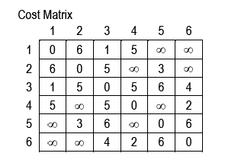
Example
1
1
Total cost = T = {(1,3), (3,6), (6,4), (3,2), (5,2)}
= 1 + 4 + 2 + 5 + 3 = 15
6
5
1
5
1
5
2
3
4
2
3
4
3
6
4
2
5
6
5
6
6
1
1
1
1
1
1
1
1
2
5
3
4
2
5
4
2
3
4
3
2
3
4
4
4
4
2
3
2
4
2
6
5
6
5
6
5
5
6

Slide 6
Algorithm
■ Algorithm Prim(G)
// Input: Directed, weighted graph, G
// Output: Minimum Spanning Tree, T
T ← φ
U ← {1} // consider vertex 1 as starting vertex
while U ≠ V do
let (u, v) be the lowest cost edge such that
u ∈ U and v ∈ V - U
T ← T ∪ {(u, v)} // add edge to spanning tree
U ← U ∪ {v}
return T
end Prim.

Slide 7
Kruskal’s Algorithm
The Kruskal’s algorithm also uses the greedy criterion to find the minimum cost spanning tree
The edge costs of a given graph, G (undirected) is arranged in ascending order.
The lowest cost edge is selected (greedy!) and included in the subgraph or spanning tree
Among the remaining edges, each edge is tried for inclusion into the spanning tree, if it doesn’t form a cycle
All the edges are tried in this way and the resulting subgraph is a minimum-cost spanning tree

Slide 8
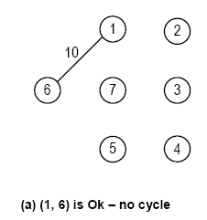
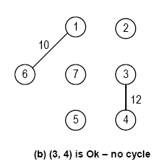
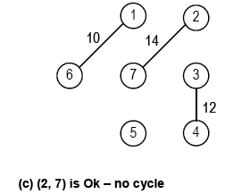
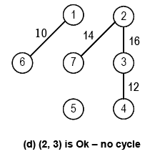
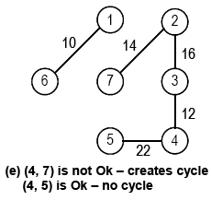
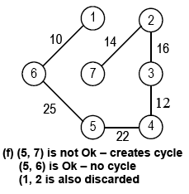
Example
Edge cost
(1, 6) - 10
(3, 4) - 12
(2, 7) - 14
(2, 3) - 16
(4, 7) - 18
(4, 5) - 22
(5, 7) - 24
(5, 6) - 25
(1, 2) - 28
1
28
2
10
14
16
6
7
3
24
18
25
12
5
22
4

Slide 9
Algorithm
■ Algorithm Kruskals(G)
// Input: Undirected graph , G
// Output: Minimum Spanning Tree, T
T ← φ
Ecount ← |V| - 1
while T ≠ n - 1 and Ecount ≠ 0 do
// assuming that edges are stored in a min heap
Get the mincost edge from E and call it as (u, v)
if (u, v) does not form a cycle
T ← T ∪ (u, v) // add (u, v) in T
Delete (u, v) from min heap
Ecount = Ecount – 1
return T
end Kruskals.

Slide 10
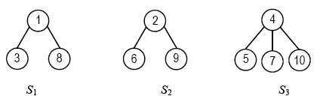
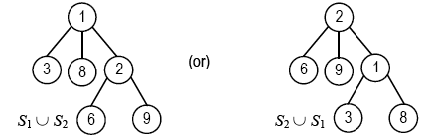
Determining Cycle Formation
To find the cycle, we use Union and Find algorithms
Disjoint Set Union: If S_{i} and S_{j} are two disjoint sets, then their
S_{i} ∪ S_{j} = {all elements in S_{i} or S_{j}}.
S₁ = {1, 3, 8}, S₂ = {2, 6, 9}, and S₃ = {4, 5, 7, 10}

Slide 11
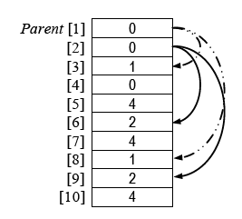
Data Structure for Disjoint Sets
To store the tree, a simple implicit array representation of linked list, Parent is used with just a link field

Slide 12
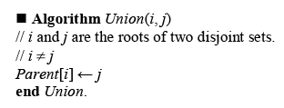
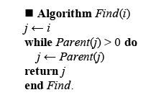
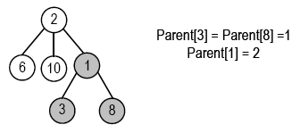

Algorithm for Union & Find

Slide 13
Algorithm
■ Algorithm Kruskals(G)
i ← 0
mincost ← 0
while i < n - 1 and heap ≠ 0 do
Delete the min-cost edge (u, v) from the heap
j ←Find(u)
k ← Find(v)
if j ≠ k // does not form a cycle
i ← i + 1
T[i, 1] ← u
T[i, 2] ← v
mincost ← mincost + Cost[u, v]
Union(j, k)
if i ≠ n - 1
write "No spanning tree"
else return mincost
end Kruskals.

Slide 14
Summary

